Slide 1
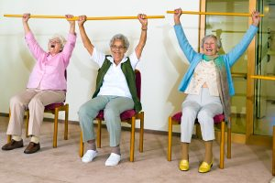
BENEFITS OF EXERCISE
Notes:
Provide hand outs

Slide 2
Is exercise/being active important?
If so, why is exercise/being active important to you?
Notes:
To start with, put your hand up if you think exercise is important.
Can you give me one reason why it’s important to you?
Awesome. You’ve brought up some amazing personal reasons to why exercise is important and beneficial, so let’s dig deeper.

Slide 3
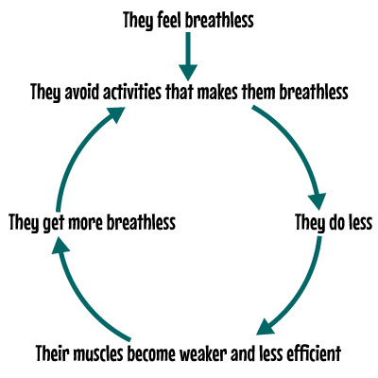
VICIOUS CYCLE OF INACTIVITY
Notes:
We all know deep down that not moving isn’t any good for us, however this is a cycle that we often get ourselves into.
When you have a lung condition, usually the starting point is that you feel breathless, and because of that you stop doing activities that make you breathless- you do less- you think it’s good but then your muscles weaken without you noticing, and your body actually gets worse rather than gets better. And the cycle goes on.
I know that it’s even more difficult after an exacerbation/chest infection leading to a hospital admission. But there is good news, we can break this cycle through exercise. ☺

Slide 4
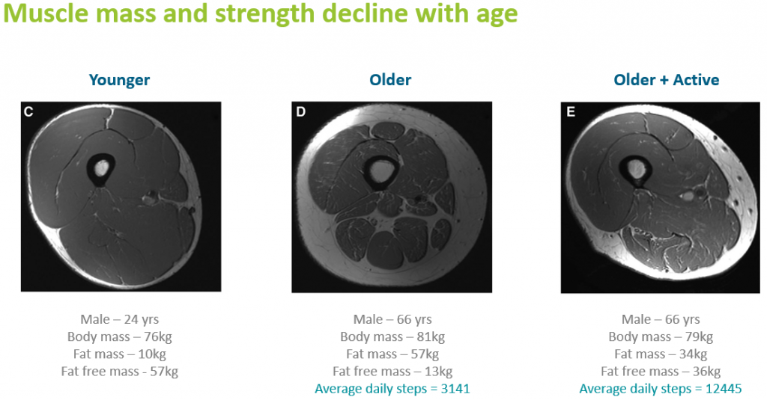
WHY do we EXERCISE?
Notes:
So, Why do we exercise? Great question.
While we were young, our body didn’t get tired from doing simple daily activities like walking around the shops, taking a shower, or walking the dog. We used to be able to do a lot of things without hassle and without even having to think about it much.
As we get older, have a look at this image. As you can see here (the dark space is muscle and the white space is fat), our muscles actually shrink and get weaker as we age.
However, if we look to the last image, this is a scan of a person who though has aged, remained active. You can see that the muscles did not shrink as much as the other one did.

Slide 5
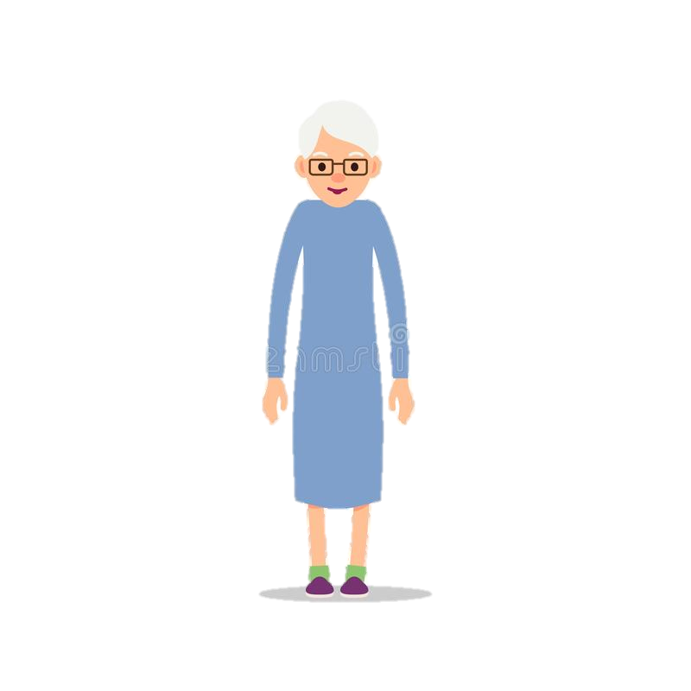
Physical Benefits of Exercise
• Helps to prevent cardiovascular disease
• Decreases blood pressure
• Increases bone density, which may lead to a reduced risk for osteoporosis
• Increases strength to help maintain or increase independence
• Increases energy
(playing with grandchildren, walking the dog)
Notes:
There’s a lot of good things that exercise can do to our bodies.
Makes heart more efficient with doing it’s job because the heart too is a muscle

Slide 6
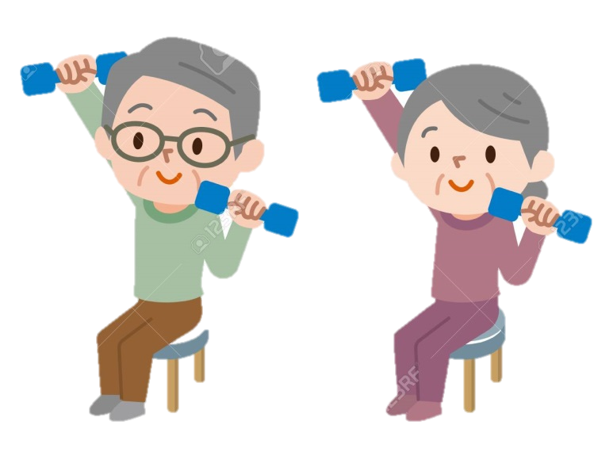
Physical Benefits of Exercise
• Increases balance, which may reduce the risk of falls or reduce the severity of a fall
• Decreases fat, increases muscle mass
• Decreases risk of injury and enhances immune function
• Increases mobility
Notes:
Lessens

Slide 7

Psychological Benefit
• Enhances mood
• Decreases depression
• Increases cognitive function
• Increases feelings of personal control
• Improves quality of life
• Increases feelings of well-being
• Decreases stress
• Improves sleep
Notes:
Exercise is not only good for the body but it’s also good for the mind because it’s all connected.

Slide 8
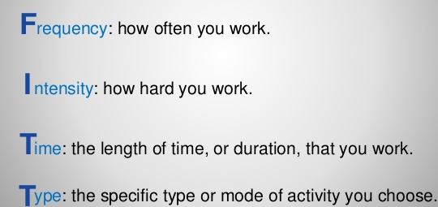
F.I.T.T. Principle
Notes:
There is a lot of benefits to exercise. Now let’s talk about how to exercise using the FITT principle. There is such thing as not enough, as well as too much so this is a good guideline of exercising.

Slide 9
Frequency
How often?
  3 days minimum a week
  4-5 days ideal
  Rest days
  Habit and lifestyle
  Keep a diary to track your progress!
Notes:
Good to keep a routine going, if you are a morning person, do exercises in the mornings on the days you do them and if not, then do it in the afternoon.

Slide 10
Intensity
How hard do I exercise?
  BORG breathlessness scale 3-4 (moderate to somewhat severe)
  Need to be puffed
  Purposeful
  Walk and Talk test
  Progression over time

Slide 11
Time
How long to exercise for?
  Continuous
  Interval
  30-60 minutes or 150 minutes a week
  Something is better than nothing

Slide 12
Type
Cardiovascular
    Walking, cycling, step ups, swimming, rowing
    Increase heart rate and breathing rate
Strength
    Free weights, body weight, therabands
    Build muscle strength and endurance

Slide 13
Tips to Exercise Safely
Warm up and Cool Down
Supportive Footwear
Layered comfortable clothing
Keep hydrated
Start gradually and progress slowly
Sustenance
    Can eat 1-2hrs before and shortly after
    If diabetic monitor blood sugar and keep a snack nearby

Slide 14
When not to Exercise
Sick with infection
Chest pain/ wheezy
Light headed or dizzy
See GP if any of the above last
If feeling indecisive… please do attend - you won’t regret it!

Slide 15
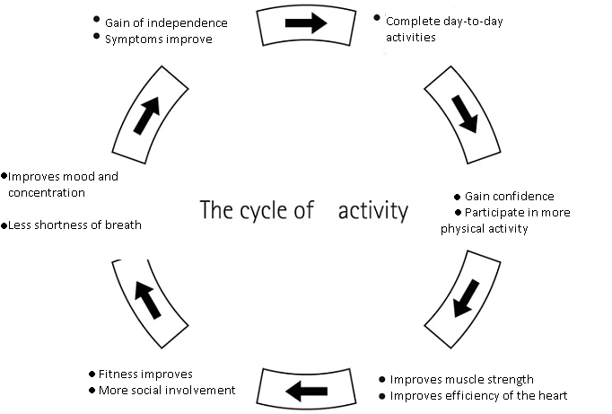
Notes:
There are many reasons why exercise is so beneficial to us. It affects both our body and mind positively. Being more active improves our overall confidence and ability to continue completing daily activities safely and engaging in activities we enjoy. Start slowly, and progress as you go. At the end of the day, remember that something is better than nothing and that actually not doing anything is more dangerous than engaging in physical activity.
Important to do exercise as well as being consistent in it and moving throughout the day.

Slide 16
Summary
BE active, and STAY active.
Do activities you actually enjoy.
We recommend 3-5x a week, BORG 3-4, Cardio + Strengthening, 30-60 minute per day or 150 minutes of exercise a day but really something is better than nothing.
Remember not doing anything is more dangerous than engaging in physical activity.
Notes:
(even if it means a 5 minute walk along your hall at home)
a mixture of both cardio and strengthening exercises/activities you enjoy that gets your heart pumping
Start slowly, and progress as you go.
At the end of the day, remember that something is better than nothing and that actually not doing anything is more dangerous than engaging in physical activity.

Slide 17

Questions

